Slide 1
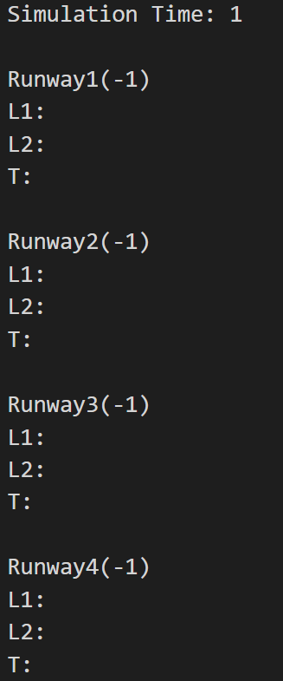
T = 1
Step 0:
Initial queue state

Slide 2
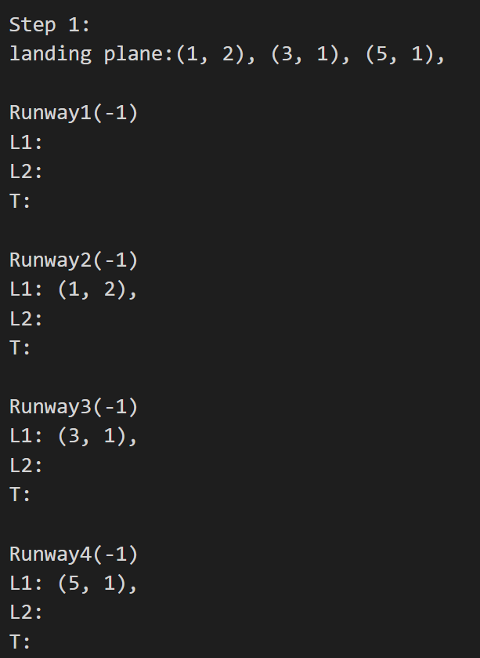
Plane id
Fuel level
T = 1
Step 1:
Handle landing planes.

Slide 3
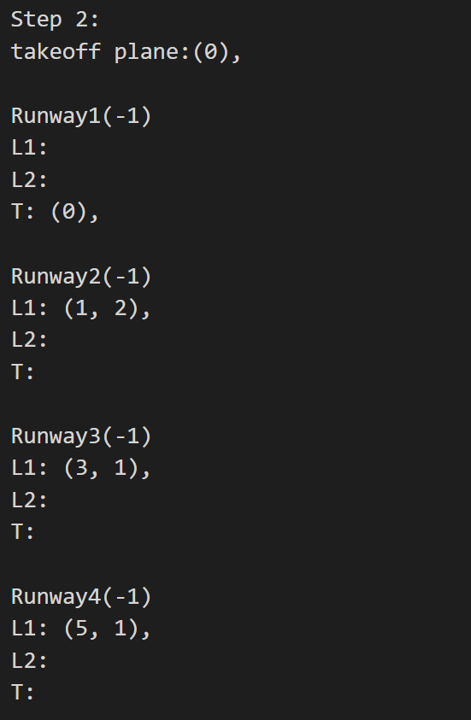
Plane id
T = 1
Step 2:
Handle takeoff planes.

Slide 4
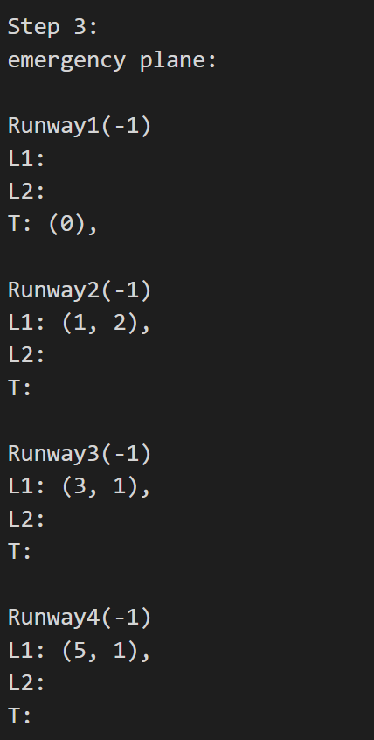
If there are emergent planes, you need to print their id here.
T = 1
Step 3:
Check whether there are emergent planes.

Slide 5
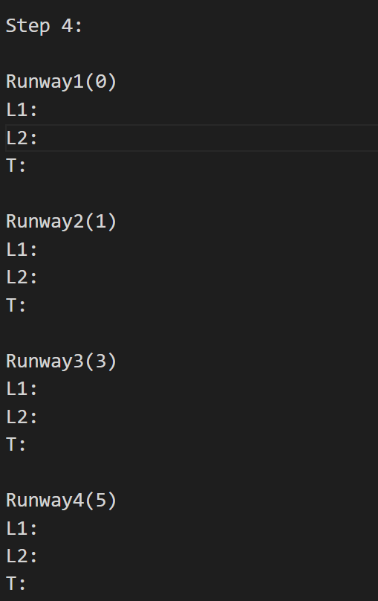
Id of the chosen plane.
T = 1
Step 4:
Each empty runway chooses a plane.

Slide 6
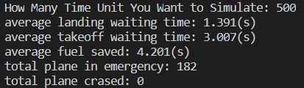
After simulation, you need to print the statistics information.

